Slide 1
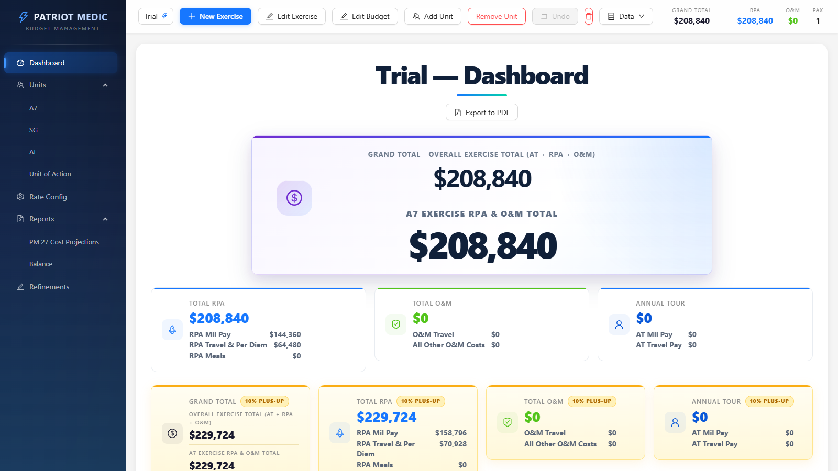
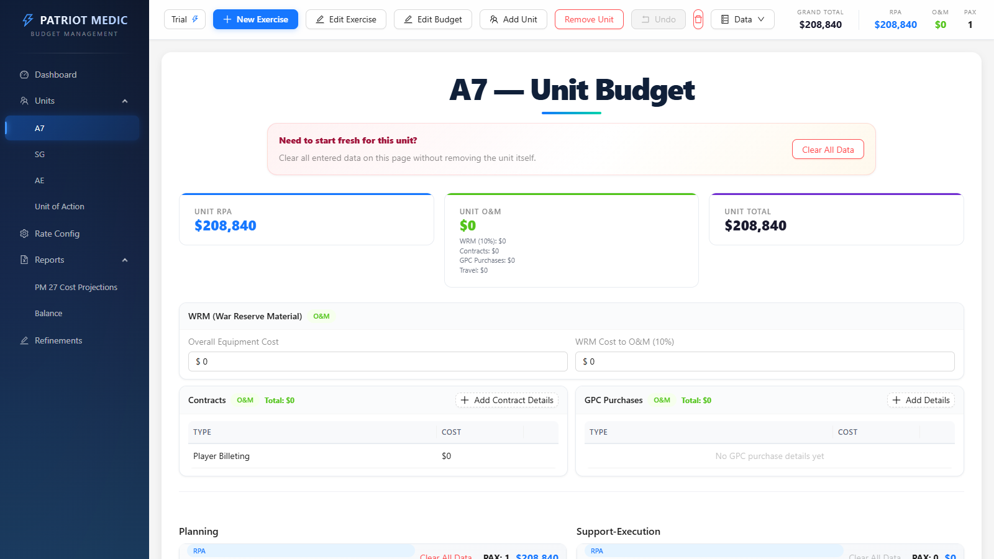
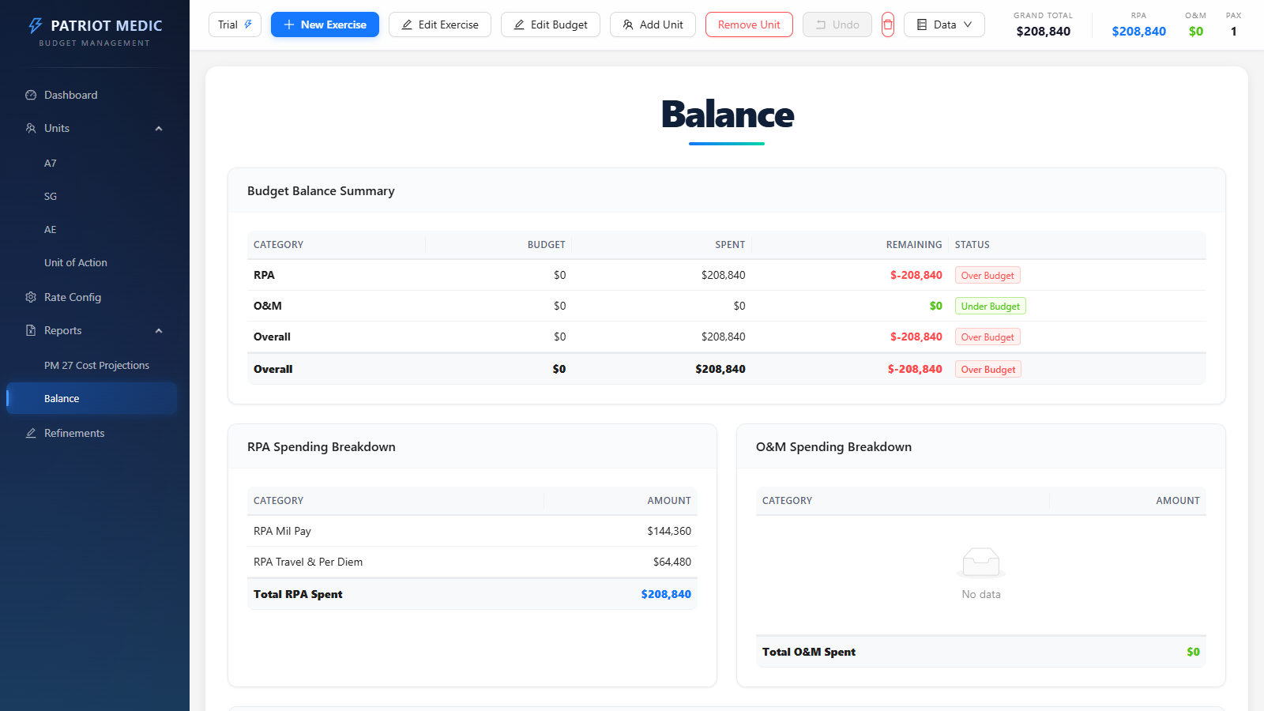
EXECUTIVE BRIEF
01 / 08
PATRIOT MEDIC | CHINA TRACKER
Exercise Budget Planning
Without Excel Fragility
China Tracker turns unit inputs, rate tables, and reporting requirements into one live planning picture that leadership can trust.
Dashboard
01
Why it matters now
The application already replaces disconnected workbook logic with a single web-based planning surface that updates immediately.
Reports
Unit View
REAL-TIME TOTALS
AUDIT-FRIENDLY
EXPORT-READY
Notes:
Open with the mission: this is the transition from spreadsheet budgeting to a live, briefing-ready planning surface. Briefly point to the three screenshots as proof the product already spans executive view, unit planning, and reporting.
Sources:
- README.md
- USER_GUIDE.md
- ChinaTracker_PRD_v2.md

Slide 2
HOW THE APP WORKS
02 / 08
How the App Works
The workflow mirrors how planners already think, but the calculations and rollups happen automatically.
1
Create or select an exercise
2
Configure rates and targets
3
Build each unit page
Set the exercise name, date range, and default duty day assumptions once at the top.
Adjust CPD, per diem, travel, meal, and budget target assumptions in one controlled location.
Enter PAX, locations, duty days, and detailed planning or execution inputs for each unit.
4
Review live rollups
5
Export and refine
Dashboard, balance, and report views update automatically as soon as a planner changes data.
Use reports, print/PDF, Excel export, refinements, clear tools, and undo to support the briefing cycle.
Structured input -> calculation engine -> leadership-ready output
Notes:
Walk through the five steps from left to right. Emphasize that the app follows the planning rhythm users already know, but the rollups and calculations happen automatically in the background.
Sources:
- README.md
- USER_GUIDE.md
- ChinaTracker_PRD_v2.md

Slide 3
WHY IT BEATS EXCEL
03 / 08
Why It Is Better Than Using Excel
Spreadsheet flexibility helps early on, but briefing-quality planning demands consistent logic, traceability, and faster scenario changes.
Excel pain points
Excel
China Tracker
Version drift, hidden formulas, and manual rollups create friction exactly when the audience expects confidence and speed.
Manual links across tabs
Central calculation rules and structured inputs
Formula integrity
Speed to update
Rework sheets and totals
Every change recalculates immediately
Manual cross-sheet formulas are hard to defend live.
Duplicate workbook versions
Clear tools and undo support rapid what-ifs
Scenario testing
Scenario testing usually means copy, paste, and reformat.
Difficult lineage in the brief
Costs stay grouped by unit, funding type, and section
Traceability
Leadership views often require a second workbook pass.
Manual cleanup before sharing
Reports, print/PDF, balance view, and Excel export
Output readiness
Team continuity
Depends on workbook knowledge
Saved exercises with consistent application flow
Notes:
Keep this leadership-focused. The message is not that Excel is bad; it is that spreadsheets become fragile when the audience expects shared logic, speed, and a defensible briefing trail.
Sources:
- README.md
- USER_GUIDE.md
- ChinaTracker_PRD_v2.md

Slide 4
MAIN FEATURES
04 / 08
Main Features
The application combines executive visibility, detailed planning controls, and briefing output in one connected workflow.
LIVE
UNIT
RATE
Real-time rollups
Unit-specific planning
Rate configuration
Grand total, RPA, O&M, and PAX update immediately as users change any planning input.
SG, AE, CAB, and A7 each have purpose-built sections for planning, players, white cell, and support logic.
CPD, per diem, meals, airfare, rental assumptions, and budget targets are maintained centrally.
RPT
NOTE
SAFE
Reporting and export
Refinements workspace
Safety controls
Balance, print/PDF, and Excel output make the same live data ready for briefings and follow-on documents.
Improvement notes, status tracking, and follow-up context live inside the app instead of in side notes.
Section clear, unit clear, authenticated persistence, and 10-step undo reduce the risk of bad edits during preparation.
Notes:
Use this slide to summarize what matters operationally: real-time totals, structured unit inputs, reporting, refinements, and safety controls like clear actions and undo.
Sources:
- README.md
- USER_GUIDE.md
- ChinaTracker_PRD_v2.md

Slide 5
LIVE DEMONSTRATION
05 / 08
Live Demonstration: Executive Dashboard
Leadership can immediately see total cost, funding split, PAX, and unit-level impact from one screen.
At-a-glance totals
Grand Total, RPA, O&M, and PAX are visible immediately at the top of the screen.
Executive briefing table
Unit-level totals summarize how SG, AE, CAB, and A7 each contribute to the overall cost picture.
Visual comparison
Charts make the funding mix and cost distribution easier to explain in a live room.
Fast scenario review
A planner can update assumptions and keep leadership oriented without leaving the application.
Dashboard
Notes:
During the live portion, show how leadership can read total cost, funding split, unit table, and visual charts from one screen. This is the fastest way to orient a room.
Sources:
- README.md
- USER_GUIDE.md
- ChinaTracker_PRD_v2.md

Slide 6
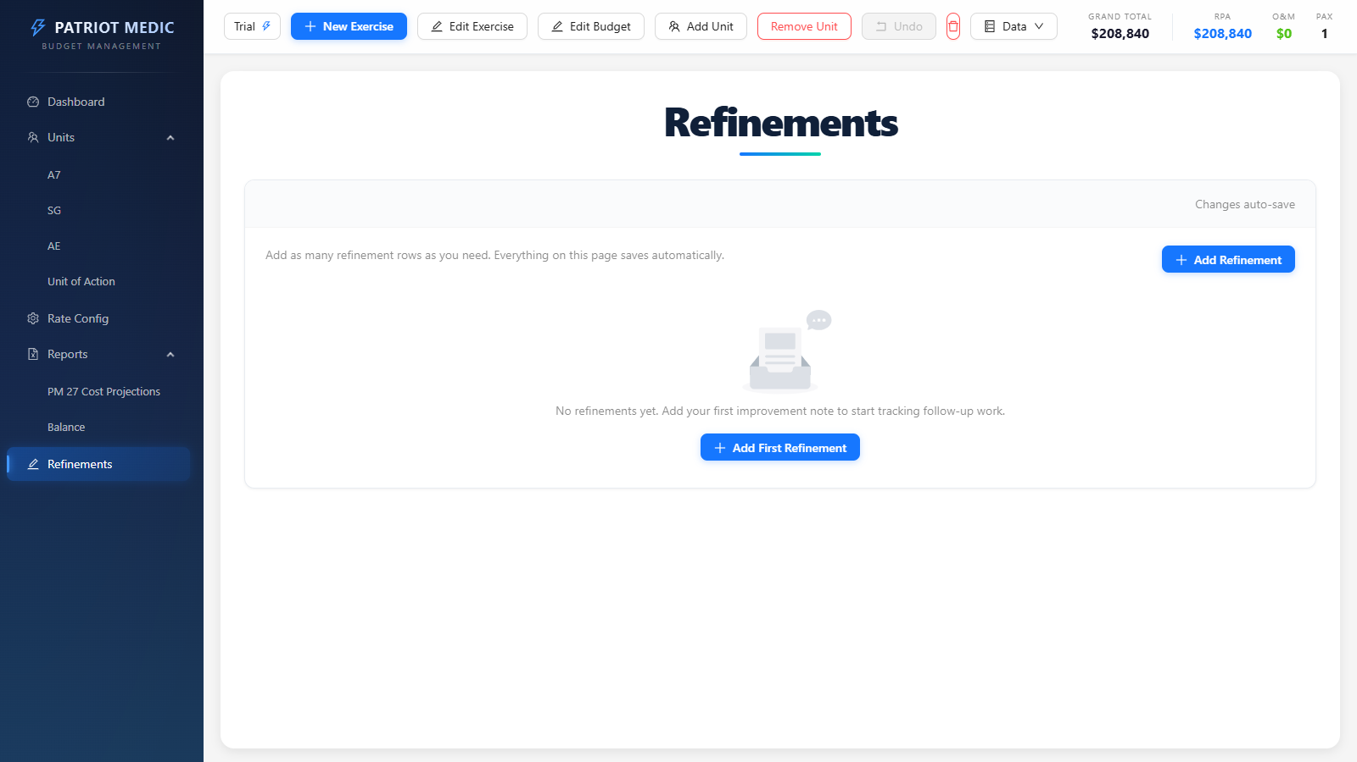
LIVE DEMONSTRATION
06 / 08
Live Demonstration: From Unit Entry to Reporting
The same data drives detailed unit planning, report generation, and the refinements loop.
Reports
ENTER COST DRIVERS
Unit pages let users work at the level planners actually need: section totals, duty days, locations, contracts, and execution costs.
BRIEF + FOLLOW UP
Report output and refinements keep the briefing package and improvement tracking inside the same environment.
Unit Planning
Refinements
Notes:
This slide shows that the same data model supports detailed unit planning and polished reporting. It also highlights that follow-up work can now be tracked inside the tool instead of on side notes.
Sources:
- README.md
- USER_GUIDE.md
- ChinaTracker_PRD_v2.md

Slide 7
FUTURE POTENTIAL
07 / 08
Future Potential Uses and Improvements
The current version already replaces manual budgeting; the next phase can turn it into a broader planning platform.
Near-term
Next expansion
Strategic potential
Improve the current operating loop
Strengthen planning depth
Turn the tool into decision support
Role-based permissions and approval flow
Scenario versioning and side-by-side comparisons
Forecasting for future budget posture
Saved report packs and leadership templates
Exercise history and trend snapshots
Recommendation support for staffing or travel changes
More guided setup for new exercises
Portfolio view across multiple exercises
Cross-functional planning beyond a single briefing cycle
Potential future use cases
Funding drills
Scenario rehearsal
After-action lessons
Portfolio review
Decision support
Notes:
Frame the roadmap as realistic extensions of the current foundation: approvals, scenario management, portfolio visibility, and decision support. The point is that the current app can grow into a platform.
Sources:
- README.md
- USER_GUIDE.md
- ChinaTracker_PRD_v2.md

Slide 8
CLOSING
08 / 08
What This Enables
Faster planning cycles. Cleaner leadership briefings. More confidence in the numbers.
01
Faster decisions
02
More defensible briefs
03
Better continuity
Leaders can ask 'what if' questions and get an updated answer without a workbook rebuild.
Every total ties back to structured unit inputs, rate assumptions, and repeatable logic.
Refinements, exports, clear actions, and undo reduce rework across the full preparation cycle.
Patriot Medic is already a stronger planning surface than a spreadsheet and is positioned to grow into a broader decision-support platform.
Notes:
Close on outcomes: faster decisions, better traceability, and cleaner leadership briefings. This should leave the audience with confidence that the app is useful now and expandable later.
Sources:
- README.md
- USER_GUIDE.md
- ChinaTracker_PRD_v2.md

